Slide 1


NEXT GEN EMPLOYABILITY PROGRAM
CREATING A FUTURE-READY WORKFORCE
Student Name :
Aastha Saha
Student ID :
College Name :
STU65c3395b99fb61707293019
Techno International New Town

Slide 2
CAPSTONE PROJECT SHOWCASE
Project Title
Creating A Job Portal Application (Job Finder)with Django
Framework
Abstract | Problem Statement | Project Overview | Proposed Solution | Technology Used | Modelling & Results | Conclusion | Q&A

Slide 3
Abstract
1
Objective: The project aims to develop a job portal using the Django web framework, facilitating job seekers to search and apply for jobs, and employers to post job listings and manage applications.
2
Implementation: After setting up the Django project structure and configuring the necessary settings, we created three apps authuser,Hr and candidate. Next we implemented the required models, templates, static files and urls in each app.
3
Features: This website includes user and Hr registration, explore job section, job posting section, details of candidate who’ve applied for job, candidate dashboard, Hr dashboard etc.
4
Result: A fully functional job portal that allows job seekers to search and apply for jobs, and enables employers to post job listings and manage applications effectively.

Slide 4


Problem Statement
Develop a job portal using the Django web framework, facilitating job seekers to search and apply for jobs, and employers to post job listings and manage applications.

Slide 5

Project Overview
After setting up the Django project structure we have implemented three apps authuser, hr and candidate.
User Authentication and Registration: We have created the authuser app to allow users (both job seekers and employers) to securely create accounts and access the portal.
Candidate: After login or registering the candidate will come to their home page. There they can go through the explore job section and also they can apply to it by giving their basic details. After applying they can check their dashboard for application status or the list of jobs they have applied.
Hr: After login or registering the hr will come to their home page. There they can post jobs according to their requirement. After posting they can check their dashboard for the candidate details who have applied and there they can accept or reject their application.

Slide 6
Proposed Solution
Start
Home Page
Candidate
Hr
No
Login
Yes
Explore Jobs
Post Job
Register
Check applied Candidate details
Apply Job
Accept
Application
Reject
Check Dashboard for application status
Exit

Slide 7
Technology used
Frontend- HTML, CSS, JavaScript
Backend- Django
Database- SQLite

Slide 8
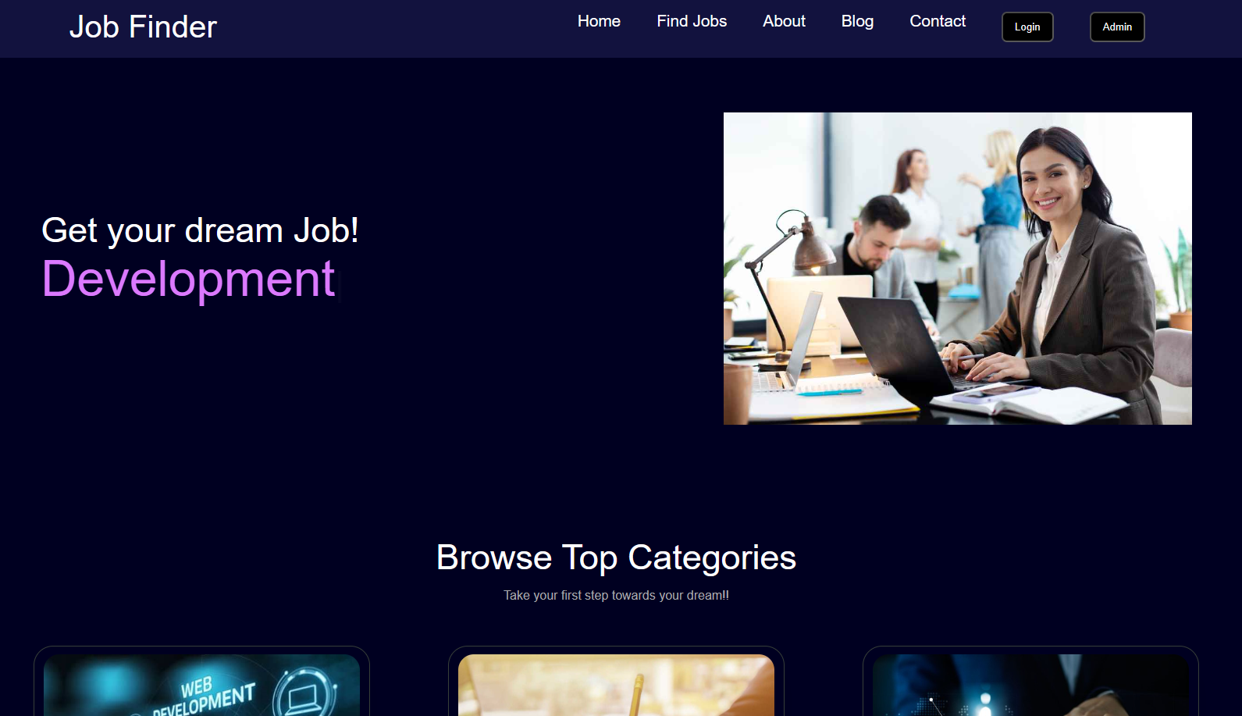
Modelling & Result
Landing Page

Slide 9
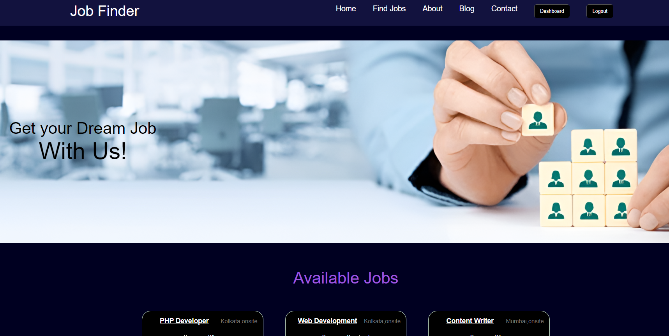
Modelling & Result
Explore Jobs

Slide 10
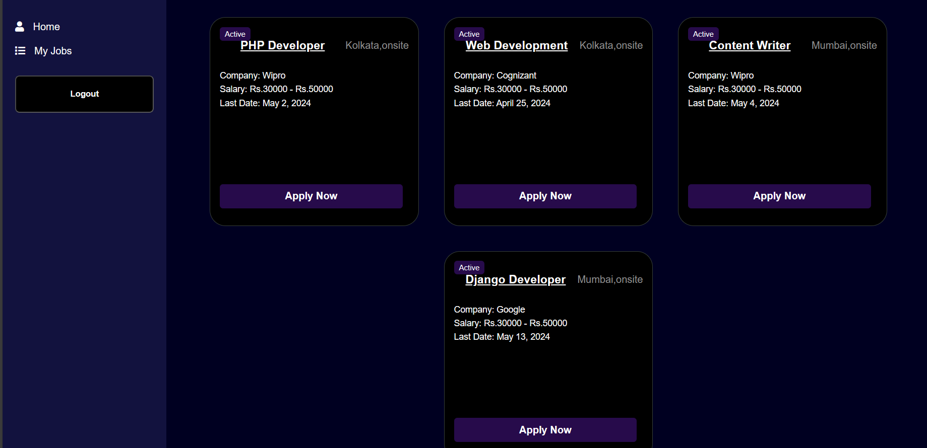
Modelling & Result
Candidate Dashboard

Slide 11
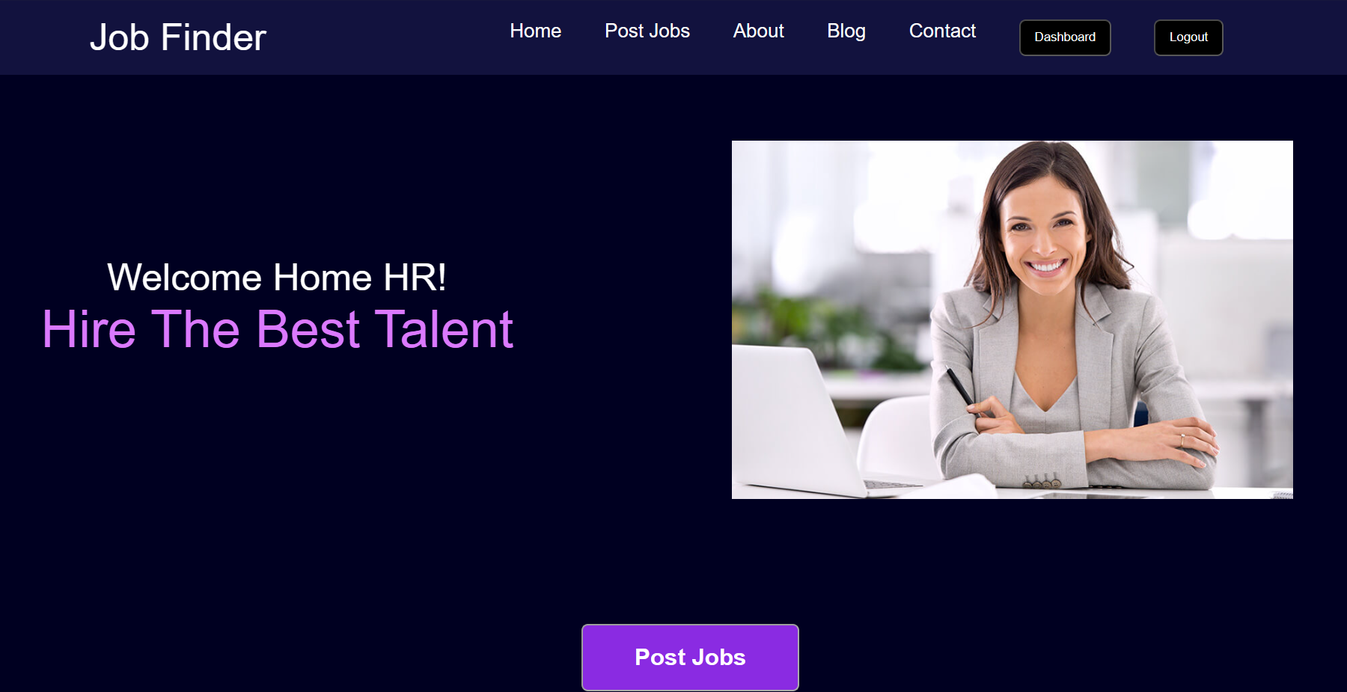
Modelling & Result
Hr Homepage

Slide 12
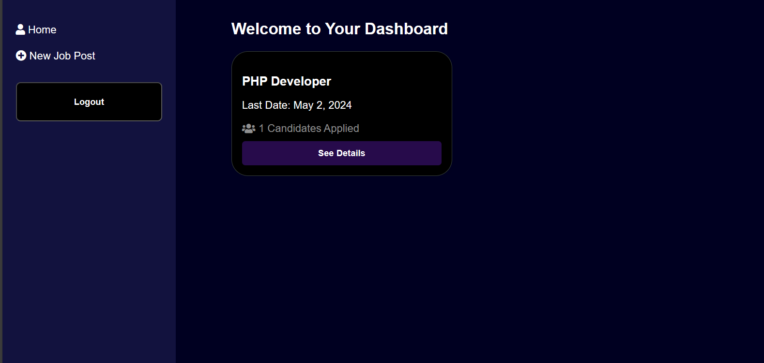
Modelling & Result
Hr Dashboard

Slide 13

Conclusion
In conclusion, the development of the job portal using the Django framework has been a significant endeavor aimed at transforming the job search and recruitment landscape. Through meticulous planning, diligent implementation, and continuous refinement, we have successfully created a platform that addresses the needs of both job seekers and employers. This platform will simplify the job search process for individuals and empowering organizations to find the right talent efficiently.

Slide 14


Notes:
Thank You !!

